Slide 1
Decision Tree Regression(CART)
Introduction
CART( Classification And Regression Tree) is a variation of the decision tree algorithm. It can handle both classification and regression tasks. Scikit-Learn uses the Classification And Regression Tree (CART) algorithm to train Decision Trees (also called “growing” trees). CART was first produced by Leo Breiman, Jerome Friedman, Richard Olshen, and Charles Stone in 1984.

Slide 2
What is Decision Tree ?
Decision Tree is a Supervised learning technique that can be used for both classification and Regression problems, but mostly it is preferred for solving Classification problems.
It consist of 3 main parts
Root node
Internal/Decision node
Leaf node
Decision Tree Terminologies:
Root Node: Root node is from where the decision tree starts. It represents the entire dataset, which further gets divided into two or more homogeneous sets.
Leaf Node: Leaf nodes are the final output node, and the tree cannot be segregated further after getting a leaf node.
Splitting: Splitting is the process of dividing the decision node/root node into sub-nodes according to the given conditions.
Branch/Sub Tree: A tree formed by splitting the tree.
Decision Node : Decision nodes are used to make the decisions in a tree.

Slide 3

Decision Tree Structure

Slide 4
What category of algorithms does CART belong to?
As the name suggests, CART (Classification and Regression Trees) can be used for both classification and regression problems. The difference lies in the target variable:
With classification, we attempt to predict a class label. In other words, classification is used for problems where the output (target variable) is Categorical e.g., whether it will rain tomorrow or not.
Meanwhile, regression is used to predict a numerical label. This means your output(target variable) is Numeric e.g., a house price

Slide 5
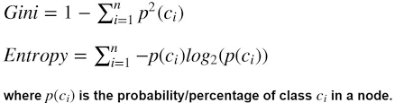
CART classification model using Gini Impurity or Entropy
In the decision tree, the nodes are split into subnodes on the basis of a threshold value of an attribute. The CART algorithm does that by searching for the best homogeneity for the subnodes, with the help of the Gini Index criterion
Splitting of decision is depends on Purity. Purity check can be done with the help of Entropy or Gini Impurity
Formula of Gini Impurity and Entropy:

Slide 6
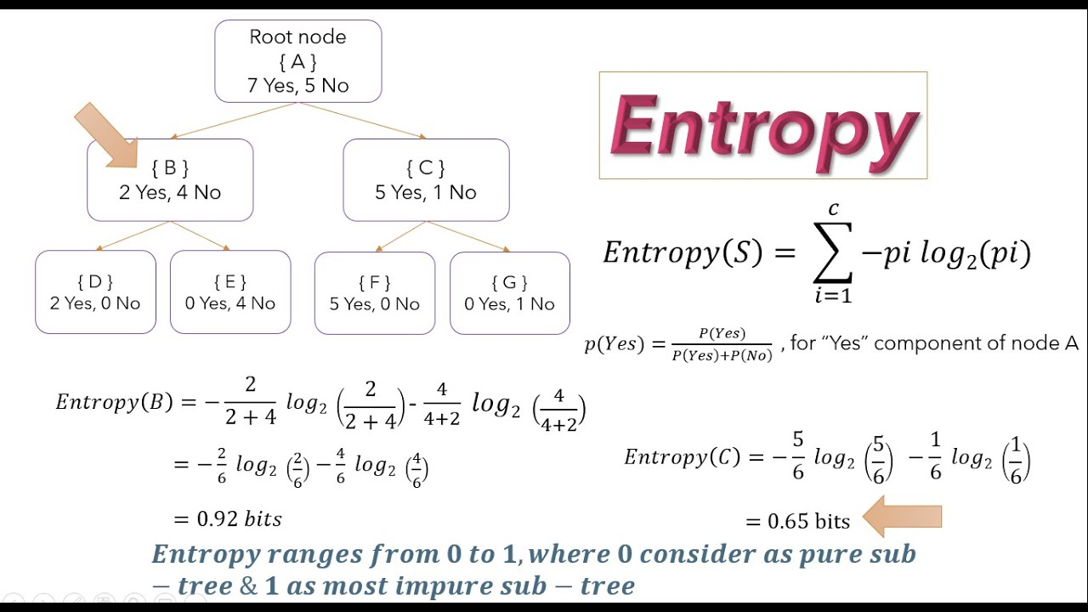

Slide 7
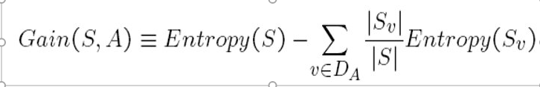
Information Gain:
Information gain is the basic criterion to decide whether a feature should be used to split a node or not.
i.e., the highest value of information gain at a node of a decision tree is used as the feature for splitting the node.
Formula for information Gain:

Slide 8
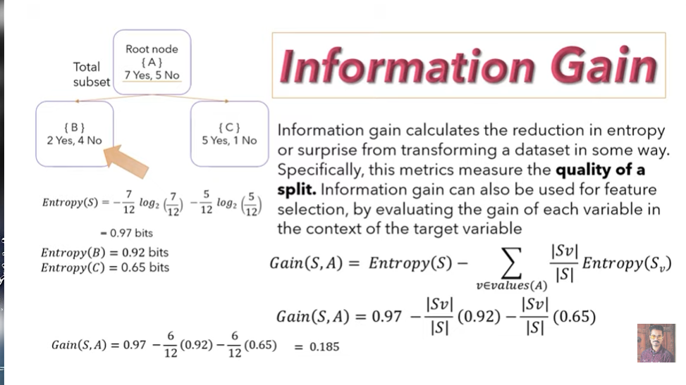

Slide 9
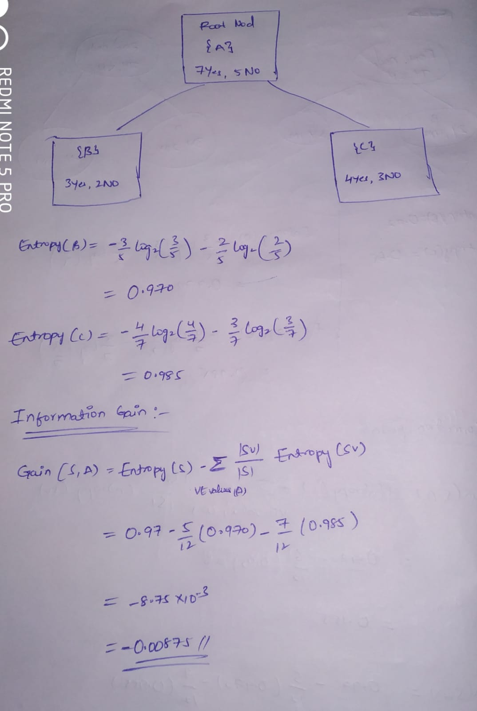

Slide 10
The lower the value of entropy, the higher the purity of the node.
Entropy value ranges from 0 to 1.
Gini impurity value ranges from 0 to 0.5.
Gini Impurity is preferred to Information Gain because it does not contain logarithms which are computationally intensive.

Slide 11
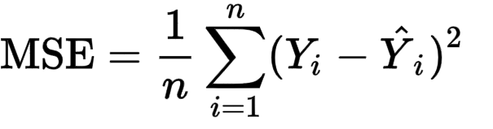
Reduction in Variance in Decision Tree
Reduction in Variance is a method for splitting the node used when the target variable is continuous, i.e., regression problems. It is called so because it uses variance as a measure for deciding the feature on which a node is split into child nodes.
We are capturing Variance by using “MSE”.
Formula:

Slide 12
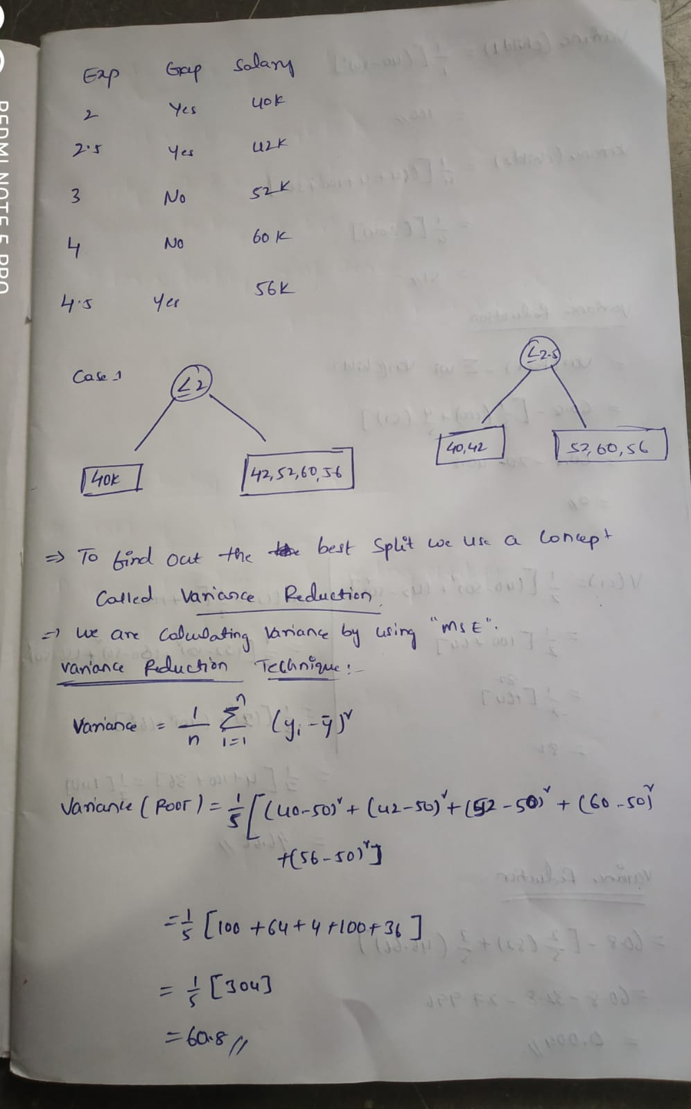

Slide 13
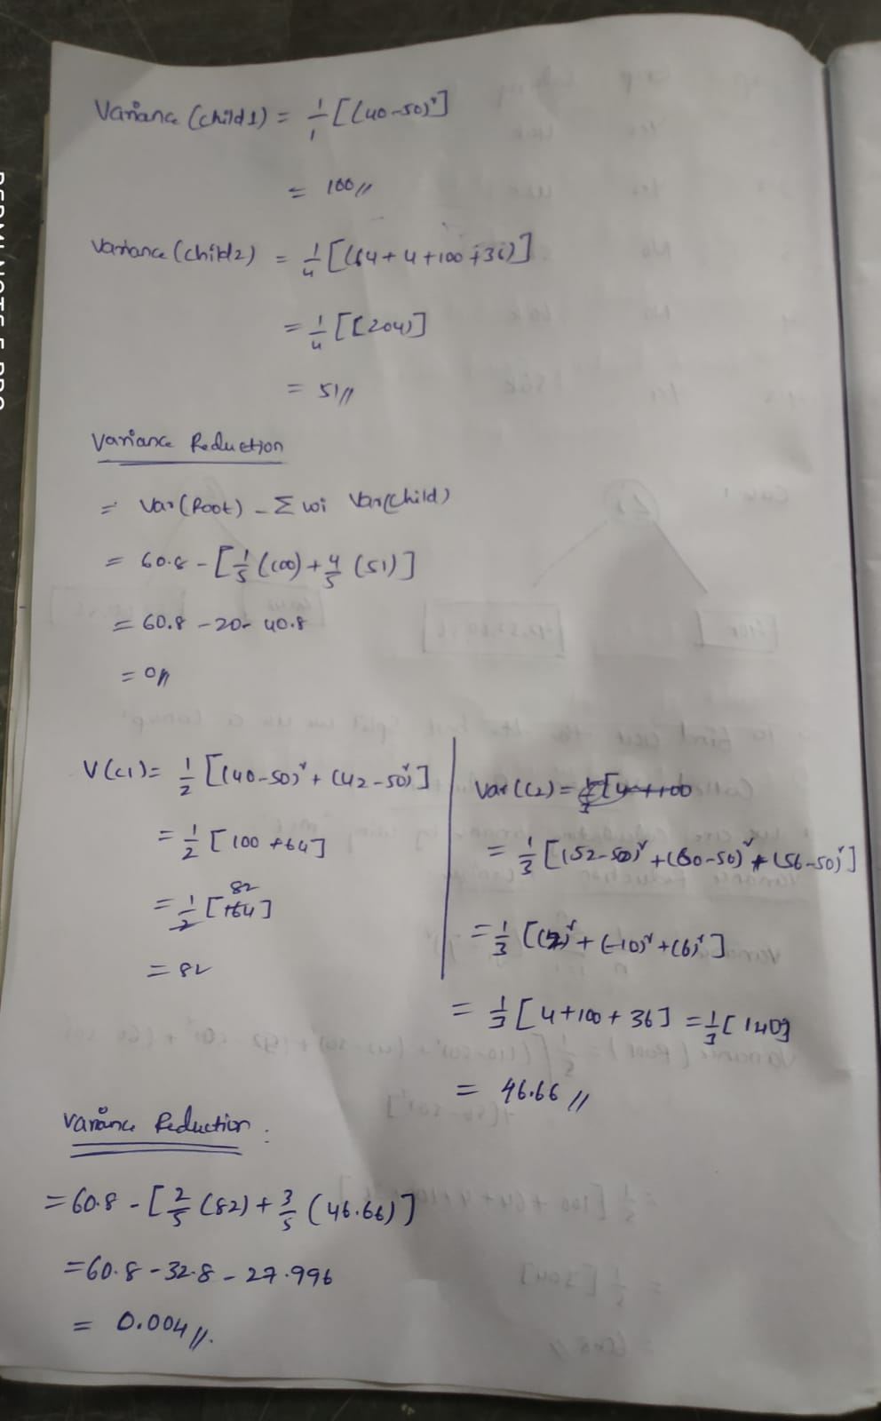

Slide 14
Advantages of CART
Results are simplistic.
Classification and regression trees are Nonparametric and Nonlinear.
Classification and regression trees implicitly perform feature selection.
Outliers have no meaningful effect on CART.
It requires minimal supervision and produces easy-to-understand models.

Slide 15
Disadvantages of CART
Overfitting.
High Variance.
low bias.
the tree structure may be unstable.

Slide 16
Applications of the CART algorithm
For quick Data insights.
In Blood Donors Classification.
For environmental and ecological data.
In the financial sectors.

Slide 17
Conclusion
CART algorithm is a popular and widely-used machine learning algorithm that offers many benefits, including its simplicity, interpretability, and ability to handle both categorical and numerical data.
CART is a powerful algorithm that is also relatively easy to explain compared to other ML approaches. It does not require much computing power, hence allowing you to build models very fast.

Slide 18
Thank You

